Slide 1
Lesson 11 - Intro to Sets
Mr Mack 2019

Slide 2
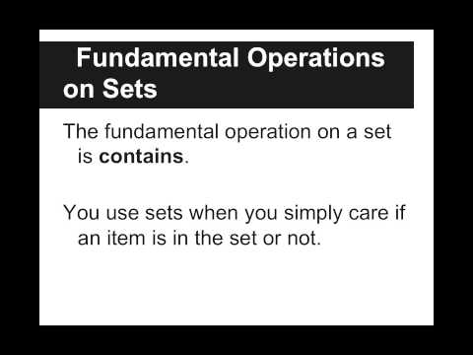
Intro to Sets

Slide 3
What is a set?
A collection of unique objects that are not in a specific order
A list of objects in a particular order
A collection of (key, value) pairs
A function

Slide 4
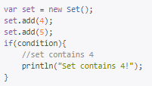
What should condition be in order to check that the set contains the element 4?
set.indexOf(4) != -1
set.contains(4)
set[4] == true
set[0] == 4

Slide 5

What is printed out by the following code?
Set: {"hello", "goodbye", "hello"}
Set: {"hello", "goodbye"}
["hello", "goodbye", "hello"]
nothing, there is a syntax error

Slide 6
Example: Basic Sets
This is an example for this lesson. You are encouraged to play around with it, run and change the code, and learn how it works. When you are done, click continue to go to the next problem.

Slide 7
Exercise 5.11.1: Vowels
Create a set that contains the vowels {"a", "e", "i", "o", "u"}
Then, let the user input letters using readLine and print whether each letter they enter is a vowel or not. If a letter is in the set, then the letter is a vowel.
Let the user continue to input letters until they type the SENTINEL, which is a blank line.
Here is a sample run:
Letter: a
Vowel
Letter: g
Not a vowel
Letter: z
Not a vowel
Letter:

